Slide 1
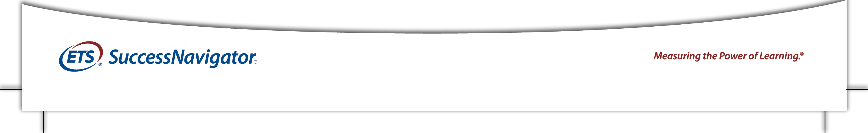
Driving Student Success
Holistic Assessment, Placement, and Support
Ross Markle, Ph.D.
Sr. Assessment Strategist, Higher Education Division

Slide 2
Agenda
Overview of noncognitive factors and student success How noncognitive data can support Holistic advising, coaching, and counseling Course placement decisions above and beyond traditional academic markers Institutional student success plans through mechanisms such as predictive modeling

Slide 3
What are Noncognitive Skills?
Conscientiousness
Sense of Belonging
Metacognition
Social Support
Factors outside of
“academic ability” or
“academic intelligence” that contribute to or are part of student learning
Teamwork
Study Skills
Self-efficacy
Motivation
Response to Stress
Test Taking Strategies
Institutional Commitment
Goal Setting

Slide 4
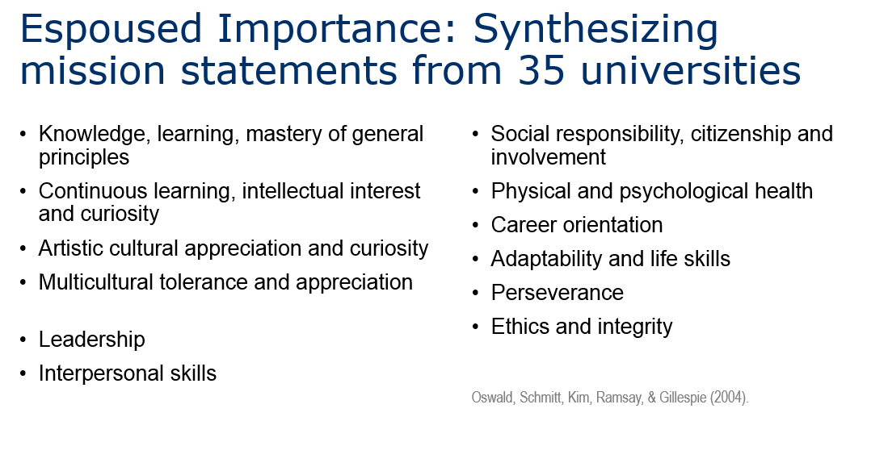
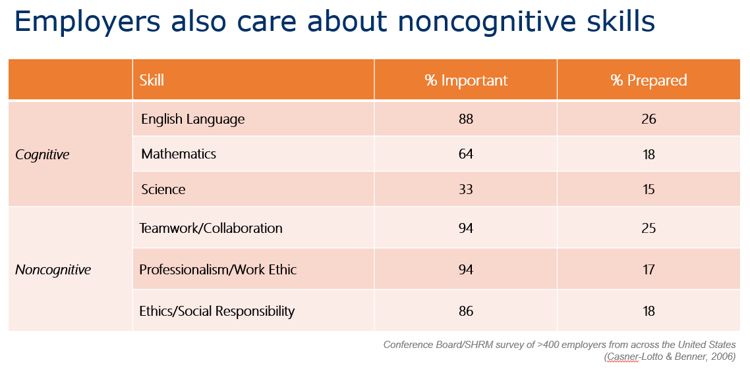
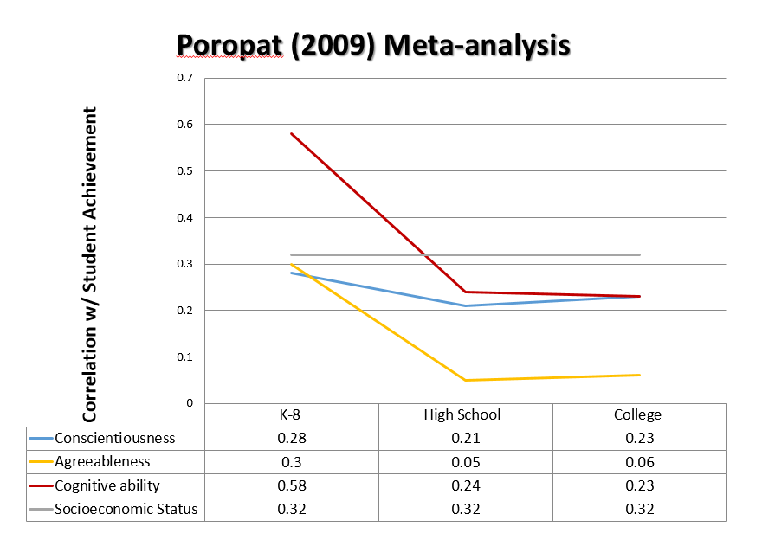
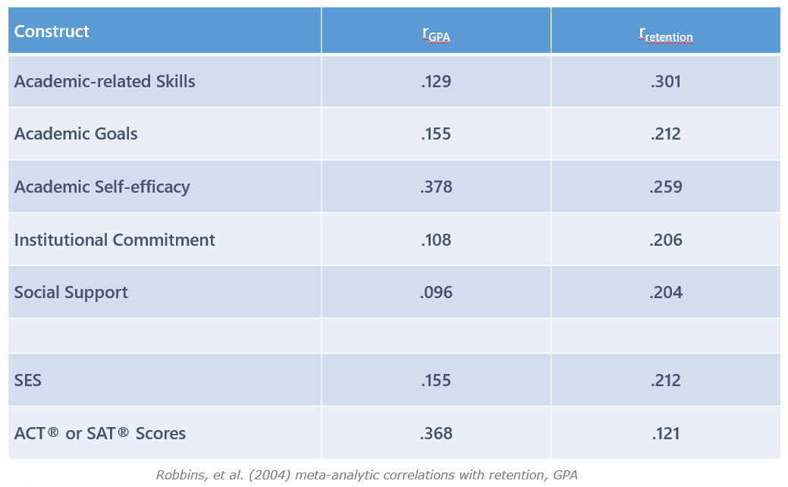
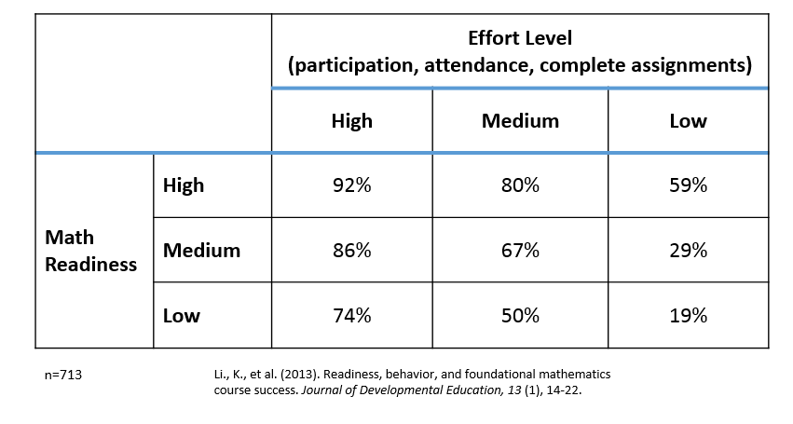
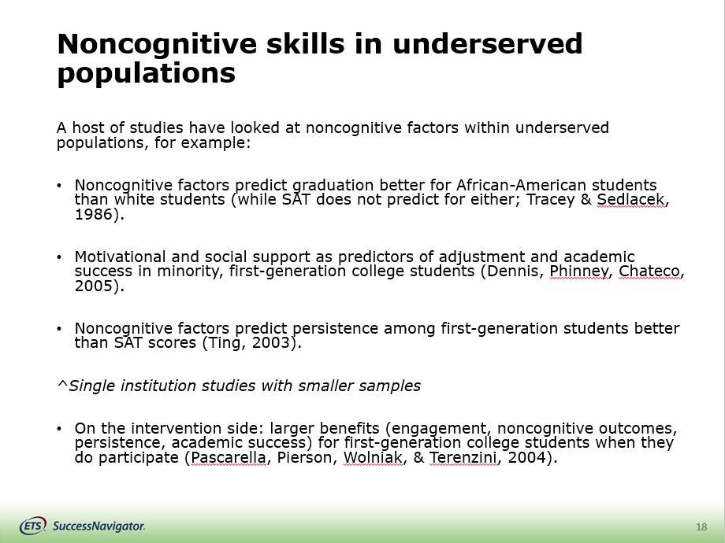
Research Into Noncognitive Skills and Student Success
Noted importance from both within and outside of higher education
Oswald et al., 2005; Casner-Lotto & Benner, 2006
Significant predictive validity
Robbins et al, 2004; Poropat, 2009; Richardson, Abraham, and & Bond, 2012
Even when controlling for previous academic achievement (test scores, HSGPA)
Equal or stronger predictor of retention than pervious academic achievement (Robbins et al., 2004; Markle et al., 2013)
Evidence for compensatory effects among students with lower academic achievement, certain traditionally underserved populations
Li et al., 2013; Tracey & Sedlacek, 1986; Dennis, Phinney, Chateco, 2005; Ting, 2003

Slide 5
A Holistic Assessment Solution
Targets students between pre and early enrollment (post admissions)
Inclusion of both cognitive and noncognitive factors
Alignment between assessment and institutional practices
Added value:
Respects the whole student (examines cognitive and noncognitive factors)
Focuses on the unique characteristics of each student
Focuses on factors educators can control such as motivation, social connectedness, as opposed to socioeconomic, situational factors

Slide 6
General Skill | Subskill | Definition | Example Items
Academic Skills Tools and strategies for academic success | Organization | Strategies for organizing work and time. | I make a schedule for getting my school work done. I take due dates seriously.
 | Meeting Class Expectations | Doing what’s expected to meet the requirements of your course including assignments and in-class behaviors. | I attend almost all of my classes. I complete the reading that is assigned to me.
Commitment Active pursuit toward an academic goal | Commitment to College Goals | Perceived value and determination to succeed in and complete college. | One of my life goals is to graduate college. The benefit of a college education outweighs the cost.
 | Institutional Commitment | Attachment to and positive evaluations of the school. | This is the right school for me. I’m proud to say I attend this school.
Self-management Reactions to academic and daily stress | Sensitivity to Stress | Tendency to feel frustrated, discouraged or upset when under pressure or burdened by demands. | I get stressed out easily when things don't go my way. I am easily frustrated.
 | Academic Self-Efficacy | Belief in one’s ability to perform and achieve in an academic setting. | I'm confident that I will succeed in my courses this semester. I can do well in college if I apply myself.
 | Test Anxiety | General reactions to test-taking experiences, including negative thoughts and feelings (e.g., worry, dread). | When taking a test, I think about what happens if I don't do well. Before a test, my stomach gets upset.
Social Support Connecting with people and students resources for success | Connectedness | A general sense of belonging and engagement. | I feel connected to my peers. People understand me.
 | Institutional Support | Attitudes about and tendency to seek help from established resources. | If I don't understand something in class, I ask the instructor for help. I know how to find out what's expected of me in classes.
 | Barriers to Success | Financial pressures, family responsibilities, conflicting work schedules and limited institutional knowledge. | Family pressures make it hard for me to commit to school. People close to me support me going to college.

Slide 7
SuccessNavigator Score Reports
Advisor/Faculty Report
General Skill scores, Success Indices around academic and enrollment success
Granular feedback report based on facet scores
Used to foster conversations and interventions with student
Student Report
Feedback at domain level, NO SUCCESS INDICES
Action plans around programs and services on campus
Institutional Report (Institution Aggregate Report and Custom Institution Report)
Population and subpopulation statistics (based on normative samples) at domain and facet level
Used for strategic planning, tailoring cocurricular programs and services
Data Download
Raw data file containing student scores, score levels, and background information

Slide 8
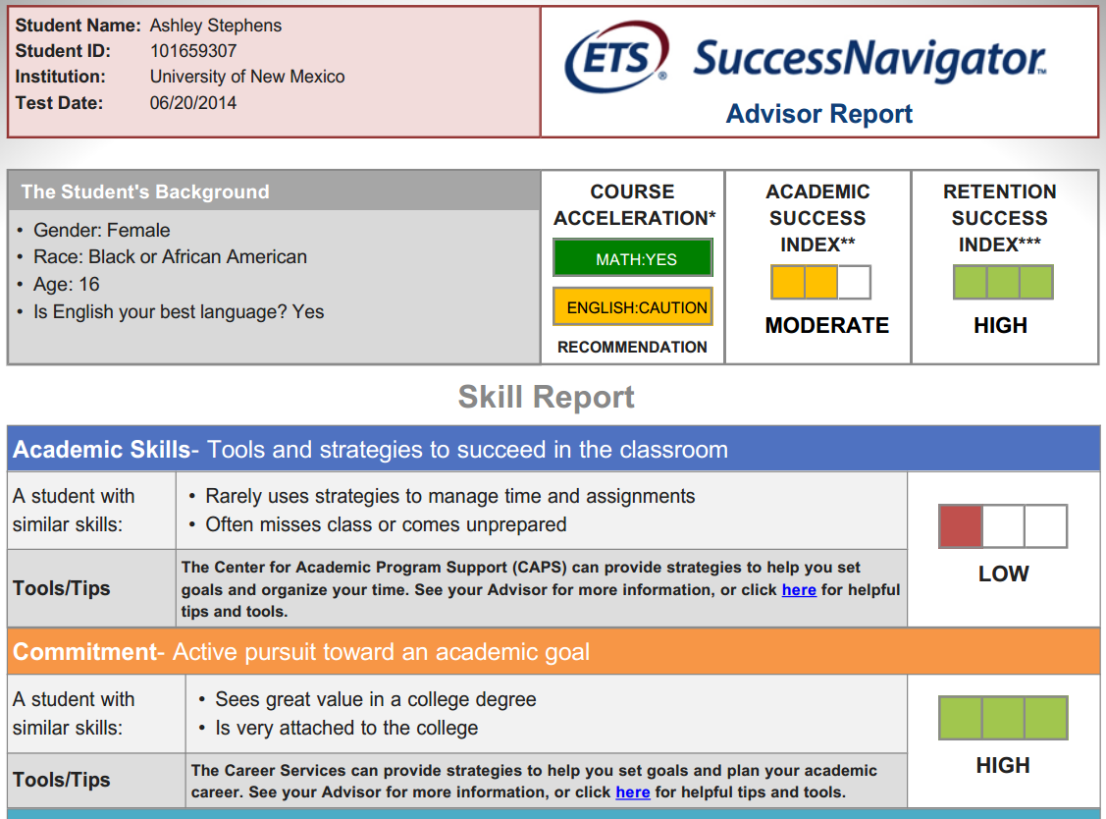
Success Indices: Separate indices for both classroom and enrollment success. Based on background, cognitive and psycho-social information and supported by statistical relationships with success.
Background Information: Communicate key student information from both SuccessNavigator® and SIS to faculty/advisor.
Domain Scores: Four general areas of student strengths and weaknesses. Scores are presented normatively.
Feedback: Determine by more specific “facet” scores (see next page).
Action Plans: Suggested interaction with programs and services on campus.

Slide 9
More about SuccessNavigator
Launched in July of 2013, SuccessNavigator has been administered to more than 100,000 students in nearly 240 colleges and universities
A diverse set of institutional partners
11 HBCUs, 42 HSIs, and 4 TCUs
38 Religiously Affiliated Institutions
Mix of urban/rural, private/public, and small/medium/large sectors
Popular implementation methods:
Course placement/ Orientation
Student success courses
Advising, coaching
Student support programs

Slide 10
Holistic Advising, Coaching, and Counseling

Slide 11
1. Collecting Student Scores
Student # | Academic Success | Retention Success
1 | LOW | MODERATE
2 | MODERATE | HIGH
3 | MODERATE | LOW
4 | LOW | MODERATE
5 | HIGH | HIGH
6 | MODERATE | MODERATE
7 | HIGH | HIGH
8 | MODERATE | LOW
9 | LOW | LOW
10... | MODERATE | MODERATE

Slide 12
2. Organizing Students
Student # | Academic Success | Retention Success
8 | MODERATE | LOW
9 | LOW | LOW
3 | MODERATE | LOW
4 | LOW | MODERATE
1 | LOW | MODERATE
6 | MODERATE | MODERATE
10 | MODERATE | MODERATE
2 | MODERATE | HIGH
5 | HIGH | HIGH
7 | HIGH | HIGH

Slide 13
3. Determining Strategies
Student # | Academic Success | Retention Success
8 | MODERATE | LOW
9 | LOW | LOW
3 | MODERATE | LOW
4 | LOW | MODERATE
1 | LOW | MODERATE
6 | MODERATE | MODERATE
10 | MODERATE | MODERATE
2 | MODERATE | HIGH
5 | HIGH | HIGH
7 | HIGH | HIGH
Intrusive interventions, continuous monitoring
Resource Library, connections, check-ins
Campus leaders, peer mentors

Slide 14
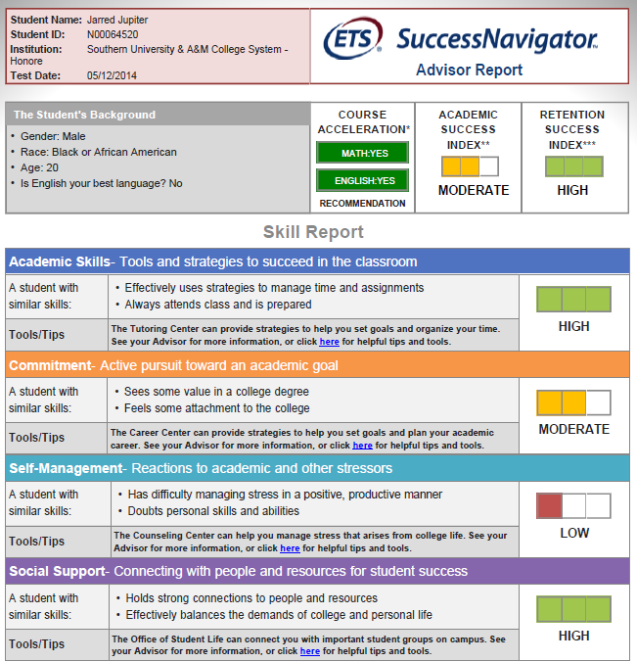
Student J
15 ACT®, 2.5 HSGPA
Strong Academic Skills
Moderate Commitment
Low Self-management
Strong Social Support
Why does Student J have such a strong likelihood of success?
What interventions might we recommend for Student J?

Slide 15
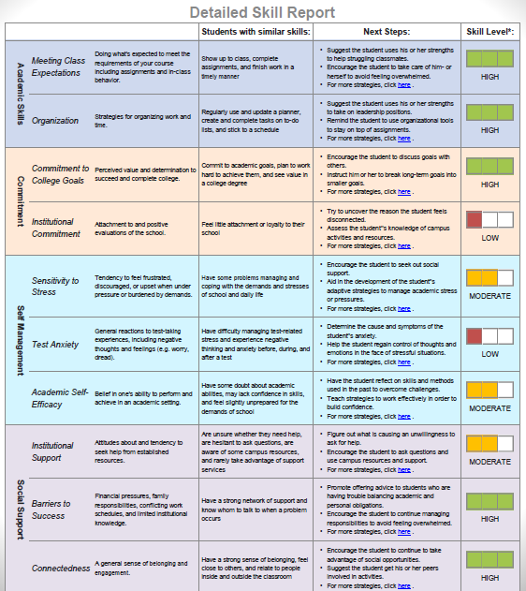
Student J
Academic Skills and Commitment to College Goals are very relevant to both academic success and persistence
Low Self-management can actually increase students’ likelihood for persistence (a lack of “stress” can also be a lack of “engagement”)
Moderate Academic Success Index is likely coming from tests scores and HSGPA: tutoring and other academic interventions are likely most important

Slide 16
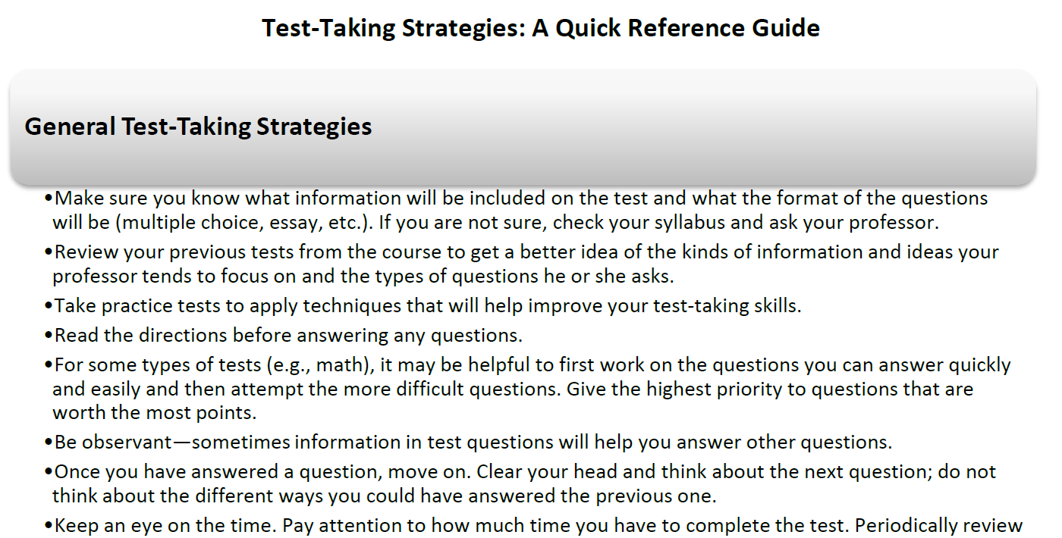
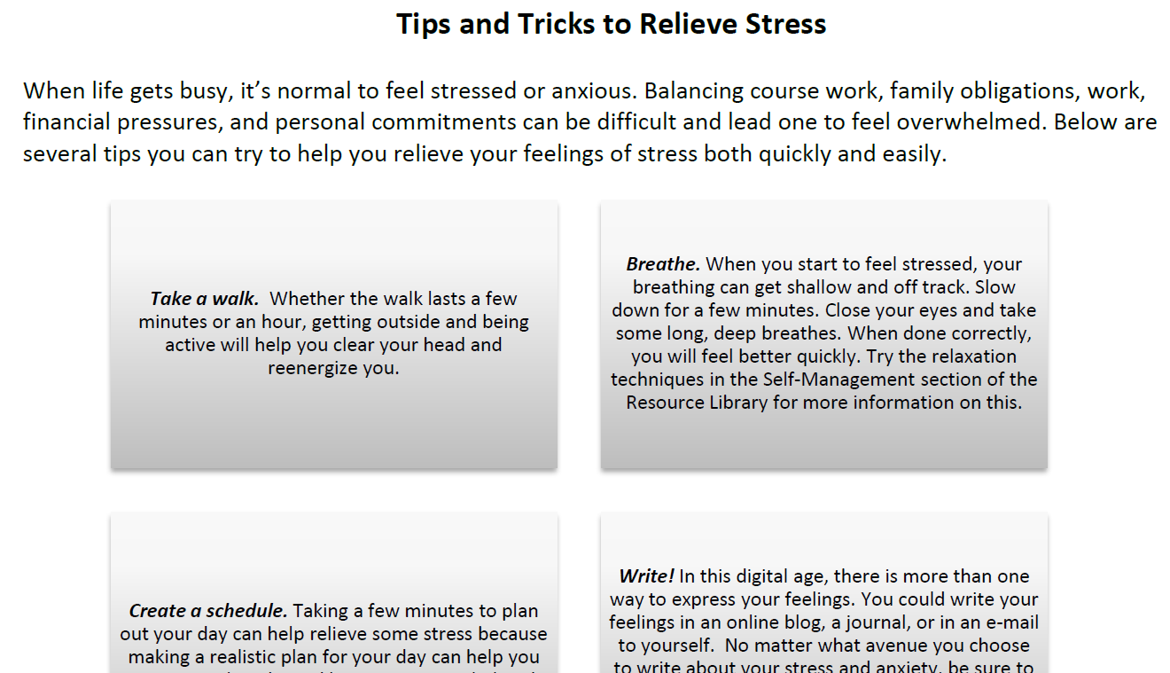
Student J – Self-management Interventions

Slide 17
Holistically Predicting Success
Student with high academic ability, but lacks social skills or strong drive
Academic success is likely, but enrollment success...?
High achieving student
Persistence and graduation likely with our without us
How do we maximize the experience?
Strong academic
preparation
“Disengaged student” - Both academic and enrollment success in danger
Will our traditional approaches work?
Student is highly motivated, but H.S. may have lacked rigor.
Likely to persist, but may struggle in classroom.
Weak academic
preparation
Noncognitive challenges
Noncognitive strengths

Slide 18
What actions should we take?
Likely to succeed, but still requires engagement: career planning or transfer
Identify noncognitive challenges and provide co-curricular supports/advising
Student with high academic ability, but lacks social skills or strong drive
Academic success is likely, but enrollment success...?
High achieving student
Persistence and graduation likely with our without us
How do we maximize the experience?
Strong academic
preparation
“Disengaged student” - Both academic and enrollment success in danger
Will our traditional approaches work?
Student is highly motivated, but H.S. may have lacked rigor.
Likely to persist, but may struggle in classroom.
SIGNIFICANT, INSTRUSIVE intervention:
“A new path”
Weak academic
preparation
Likely to succeed in college-level courses; may require academic support
Noncognitive challenges
Noncognitive strengths

Slide 19
Holistic Assessment and Course Acceleration

Slide 20
Two Paradigms for Placing Students
Content-Based Paradigm
Use placement tests to measure what students know
If a student does not meet an achievement standard, they are placed into courses that address content areas in which they are deficient
Assumptions
The goal is that each student attain a level of achievement
Academic deficiencies are best addressed by academic interventions (courses)
Academic achievement (and thus test scores) matter most

Slide 21
Two Paradigms for Placing Students
Content-Based Paradigm
Use placement tests to measure what students know
If a student does not meet an achievement standard, they are placed into courses that address content areas in which they are deficient
Success-Based Paradigm
Uses multiple measures to predict how likely a student is to succeed
If a student is not likely to succeed, interventions are targeted, based on the student’s needs, to improve their likelihood of success
Assumptions
The goal is that each student attain a level of achievement
Assumptions
The goal is that each student achieve a degree/ certificate/ transfer goal
Academic deficiencies are best addressed by academic interventions (courses)
Each student requires a different mix of curricular and co-curricular interventions
Academic achievement (and thus test scores) matter most
Both academic and noncognitive factors are relevant to success

Slide 22
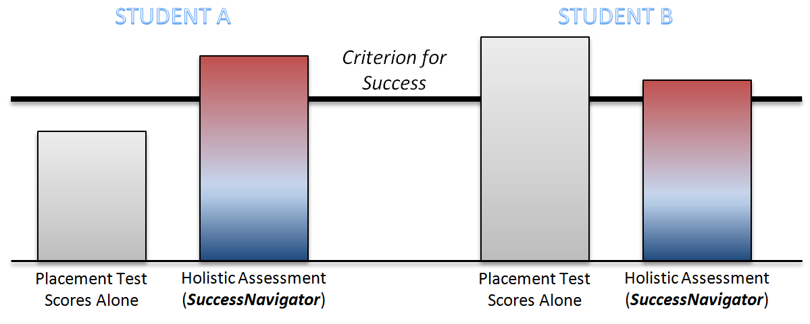
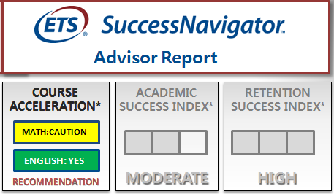

Slide 23
Test Score | Course Placement Decision
323 – 335 | DMAT 0090 (Developmental 3)
336 – 342 | DMAT 0091 (Developmental 2)
343 – 349 | DMAT 0093 (Developmental 1)
350 – 390 | Math 1314/1414, 1324, 1332, 2342/2442 (College Level)
Test Score | SuccessNavigator Course Acceleration Indicator
 | Yellow – Caution | Green - Accelerate
323 – 331 | DMAT 0090
332 – 335 | DMAT 0090 or DMAT 0091 | DMAT 0091
336 – 338 | DMAT 0091
339 – 342 | DMAT 0091 or DMAT 0093 | DMAT 0093
343 – 345 | DMAT 0093
346 – 349 | DMAT 0093 or Math 1314/1414, 1324, 1332, 2342/2442 | Math 1314/1414, 1324, 1332, 2342/2442
350 - 390 | Math 1314/1414, 1324, 1332, 2342/2442

Slide 24


Slide 25
Writing – Course Performance and Success
Course Success (C or Better) |  | Actual Placement |  |  | Total
 |  | ENG-060 | ENG-061 | ENG-105/106
Projected Placement | ENG-060 | 27.9% | 61.5% | 77.3% | 53.1%
 | ENG-061 | * | 55.9% | 68.5% | 64.2%
 | ENG-105 | ** | ** | 71.6% | 70.7%
Total |  | 28.9% | 58.7% | 71.0% | 65.4%
Students who were “accelerated” out of ENG-060 performed notably better than 43 students who were “naturally” placed in ENG-060 (n=65; d=.77 for 061; n=22; d=1.1 for 105/106). They were also 33.6% and 49.4% more likely to succeed in their courses, respectively.
Students "accelerated" from 060 to 061 performed slightly better than other students in ENG-061 (d=.15), and were 5.6% more likely to succeed in the course.
Those "accelerated" from 060 into 105/106 (n=22) performed similarly to those who were placed “naturally” (d-.00)and were 5.7% more likely to succeed.
Students "accelerated" from 061 into 105/106 (n=127) performed somewhat better than students who were placed “naturally” into ENG-061 (d=.29) and were 12.6% more likely to pass their course.
Their academic performance was slightly lower than students placed “naturally” into 105/106 (d=.14), as were their success rates (-3.1%).

Slide 26
Math Course Success – Considering Noncognitive Factors
Course Success (C or Better) |  | MAT-068 |  | Any College-Level
 |  | Caution | Accelerate | Caution | Accelerate
Projected Placement*** | Compass Algebra < =40 or ACT Math <=18 | 36.0% | 56.2% | 33.3% | 77.5%
 | Compass Algebra >40 or ACT Math >18 | -- | -- | 62.5% | 69.8%
Total |  | 35.9% | 55.6% | 50.9% | 71.8%

Slide 27
Strategies for Using Noncognitive Data to Inform Student Success Efforts
Alignment: How do our existing support mechanisms align to a framework of key noncognitive skills?
Gap Analysis: Do we have resources and strategies to support areas where students have particular challenges?
Predictive Modeling: What factors are the most salient determinants of success within our student population?

Slide 28
Charting Your Course Using Navigation Strategies …
Academic Skills | Commitment | Self-management | Social Support
CAPS Accessibility Resource Center College Enrichment & Outreach Programs (e.g., CEP, SSS) Advisement (University, Fine Arts, Engineering) Academic Coaching Academic Level Student Support (e.g., Engineering Student Services, Student Services, etc.) Faculty Office Hours (Noted on course syllabi) | Career Services Academic Departments Student Activities (i.e., Greeks, Student Organizations, etc.) Advisement (University, Fine Arts, Engineering) Alumni Support Mentoring Program Student Employment Residential Life | Student Health & Counseling Center (SHAC) CAPS Targeted Resource Centers (African-American Student Services, American-Indian Student Services, El Centro, LGBTQ Resource Center, Men of Color Initiative, Women’s Resource Center, Veteran’s Resource Center) Religious Organizations (e.g., Newman Center, etc.) College Enrichment & Outreach Programs (e.g., CEP, SSS) Academic Coaching Recreational Services_Johnson Center | Targeted Resource Centers (African-American Student Services, American-Indian Student Services, El Centro, LGBTQ Resource Center, Men of Color Initiative, Women’s Resource Center, Veteran’s Resource Center) Student Activities (i.e., Greeks, Student Organizations, etc.) College Enrichment & Outreach Programs (e.g., CEP, SSS) Dean of Students Student Employment Recreational Services_Johnson Center
http://success.unm.edu/success-navigator/index.html

Slide 29
Aligning SuccessNavigator Scores to Resources
General Skill | Counseling 20 Topic | SuccessNavigator Resources | Campus Resources
Academic Skills | Becoming an Active Learner College Textbook Reading Finding Main Ideas & Supporting Details in Texts Getting Ready for Final Exams Improving Your Concentration Improving Your Memory Matching Time Management Strategies To Your Personal Characteristics Planning Your Time/ Taking Great Lecture Notes | Choosing a Planner Calendar The Effective Workspace Checklist Getting It Done - How Much Time Do I Need for My Courses? How to Use a Planner Calendar Study Techniques Quick Reference Guide Task Estimator Tips for Being a Successful Student Example Planner Sample Study Schedule | Tutoring
Commitment | Completing Your Plan Create Your Life Story Creating Your Plan Educational Planning Exploring Majors and Careers Setting Reachable Goals Transfer Considerations What Are Your Priorities? | Characteristics of a Good Goal Unpacking Goals Is a College Degree Really Worth It? Choosing a College and Career Path Career Planning Guide | Career Services Center Internship Program Transfer Center
Self Management | Analyzing Test Taking Mistakes Managing Your Stress Objective Test Strategies Preparing for Essay Tests Protecting Your Health | Test-Taking Strategies: A Quick Reference Guide Relaxation Techniques Mindfulness Exercise Positive Self-Talk Coping Statements Self-Monitoring Productivity Activity and Mood Chart Tips and Tricks to Relieve Stress Decision Making Exercise | Psychological Services
Social Support | Enhancing Relationships Exploring Library Resources | Where to Seek Help Inventory of Teamwork Skills Effective Team Players Leadership Checklist Working in Diverse Groups Communication Skills Conflict Resolution Tips Prioritization Checklist Budget Planner | Cultural Centers Student Life

Slide 30
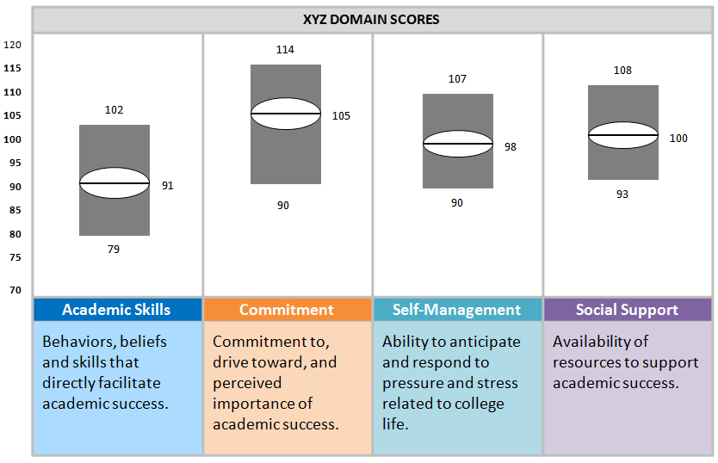
GENERAL SKILL SCORES AT COMMUNITY COLLEGE of NJ
Tutoring Advising FYE (Study Skills) | Advising Career Counseling FYE (Goal Setting) | Counseling Testing Center FYE (Test-taking Skills) | Student Life Clubs and Organizations Orientation, FYE (Help-seeking)

Slide 31
Bivariate Correlations: First-year Retention
 | UNIV 100 Grade | Most Current Cumulative GPA | First-Year Retention²
ACT Score | .043 | .101* | .005
High School GPA | .170** | .134** | .045
Organization | .181** | .227** | .079*
Meeting Class Expectations | .167** | .238** | .099**
Commitment to College Goals | .084* | .180** | .121**
Institutional Commitment | -.003 | .017 | .245**
Sensitivity to Stress | .023 | .056 | .068
Test Anxiety | .007 | .072* | .052
Academic Self-Efficacy | .185** | .265** | .074*
Connectedness | .061 | .052 | .254**
Institutional Support | .128** | .140** | .015
Barriers to Success | .120** | .203** | .083*
UNIV 1100 Grade | -- | .621** | .270**
²Note that correlations with retention are attenuated because of the binary nature of retention.
Notes:
Main focus – note that, whereas the Academic Skills components are strong predictors of the academic outcomes, they have little efficacy in predicting retention

Slide 32
Predictors
Mediator
Outcome
Meeting Class Expectations
Organization
Commitment to College Goals
Institutional Commitment
Sensitivity to Stress
Retention?
Test Anxiety
Academic Self-Efficacy
UNIV 1100 Grade
Institutional Support
Connectedness
Barriers to Success
HSGPA
ACT Score

Slide 33
Logistic Regression Results (Standardized Regression Weights)
Institutional Commitment
Β = .405
Retention?
Connectedness
Β = .433
Β = .563
UNIV 1100 Grade

Slide 34
But what does that regression coefficient really mean in terms of retention rates?
 | Institutional Commitment | Connectedness
Low (n = 216, 215) | 70.4% | 67.9%
Moderate (n = 204, 308) | 80.1% | 83.1%
High (n = 332, 229) | 86.8% | 88.7%
 | UNIV 1100 Grade
F, D, or C (n = 160) | 63.1%
A or B (n = 652) | 84.5%
Notes:
R = .467 between IC and Connect

Slide 35
Logistic Regression Results (Standardized Regression Weights)
Institutional Commitment
Β = .405
Retention?
Connectedness
Β = .433
Β = .563
What does this mean?
Institutional Commitment, Connectedness, and UNIV 1100 Grade are all significant predictors of retention, even when controlling for one another
These effects are roughly comparable
You can gain unique, significant insight into students’ likelihood of retention very early and easily
UNIV 1100 Grade

Slide 36
Strategies for Using Noncognitive Data to Inform Student Success Efforts
Alignment: How do our existing support mechanisms align to a framework of key noncognitive skills?
Can be done prior to administration
Gap Analysis: Do we have resources and strategies to support areas where students have particular challenges?
Can be done after first administration
Predictive Modeling: What factors are the most salient determinants of success within our student population?
Can be done after student outcomes are available

Slide 37
Conclusions
Noncognitive factors provide a new paradigm for understanding, assessing, and supporting students’ likelihood for success.
Our existing structures clearly aren’t supporting the outcomes we want. To build a more student-centered approach to success, we don’t just require more data, but different and better data.
However, we must be able to meaningfully turn those data into valid understanding, and subsequently into targeted, effective action.

Slide 38
Contact Information
Ross Markle
Senior Assessment Strategist – Higher Education, ETS
rmarkle@ets.org
GET REAL INSIGHTS INTO YOUR STUDENTS’ SKILLS
Email : highered@ets.org
Call: 1-800-745-0269

