Slide 1
Astra Academy: The Value of Gathering Student Satisfaction Data
John Barnshaw, Ph.D. (jbarnshaw@aais.com)
Associate Vice President – Research and Statistics
Ad Astra
Julie Bryant, (Julie.Bryant@RuffaloNL.com)
Associate Vice President – Retention Solutions
Ruffalo Noel Levitz

Slide 2
Presentation Overview
Introduction (5 Minutes)
The Value of Gathering Student Satisfaction Data (35 Minutes)
Wrap-Up (5 Minutes)
Comments and Questions (15 Minutes)

Slide 3
About Ad Astra
Ad Astra is a course scheduling and enrollment management organization that partners with over 600 institutions annually to improve course scheduling efficiency and accessibility for students.
Ad Astra offers unique solutions design to improve student retention, reduce time-to-completion, and improve graduate rates.
Astra Academy is a webinar series that brings together diverse stakeholders across the higher education landscape to share with you how their work is helping to improve student outcomes with a focus on student retention, time-to-completion, or graduation.

Slide 4
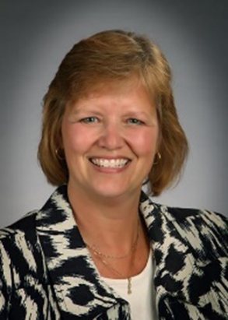
The Value of Gathering Student Satisfaction Data
Julie Bryant: Associate Vice President of Retention Solutions
October 3, 2017

Slide 5
The Case for Conducting Student Satisfaction Surveys
Notes:
I want to begin by sharing why student satisfaction surveys are important for you to conduct on your campus.

Slide 6




Student satisfaction is linked with:
Institutional alumni giving (higher)
Institutional loan default rates (lower)
Individual student retention (higher)
Institutional graduation rates (higher)
Learn more here: www.RuffaloNL.com/benchmark
Notes:
We have learned in recent years that student satisfaction is linked with key institutional metrics. Recent studies have shown that student satisfaction is linked with key institutional metrics, including higher individual student retention, higher institutional graduation rates, higher institutional alumni giving and in some cases, lower institutional loan default rates. If you are interested in learning more about these studies, they are available on our Website with the URL shortcut of benchmark, as noted on this slide.

Slide 7
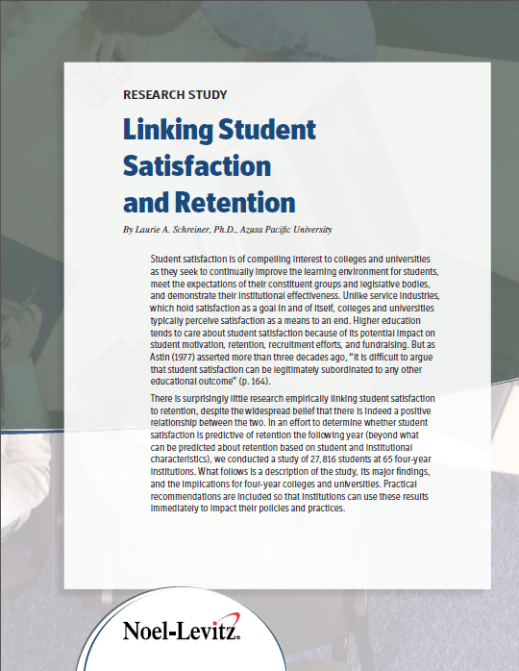
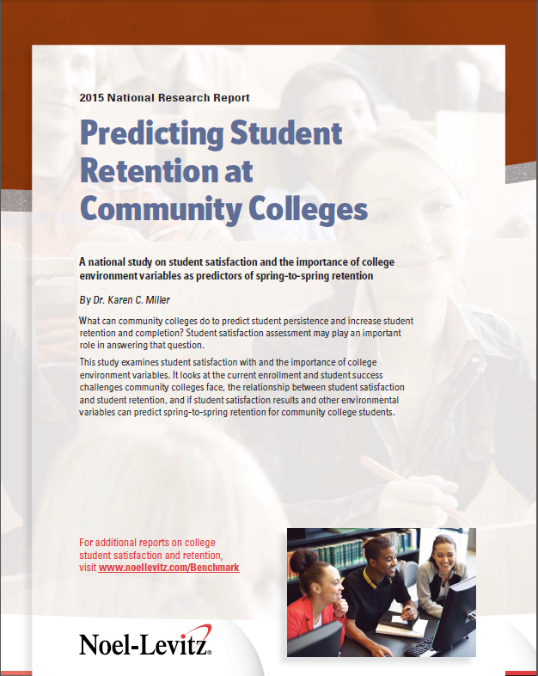
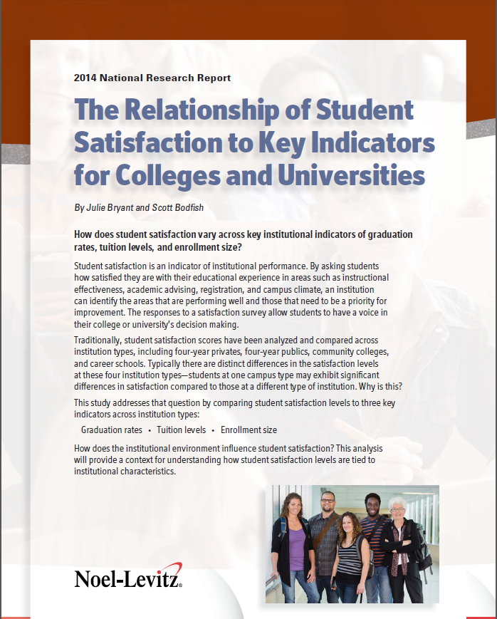
Retention:
Linking Student Satisfaction and Retention (2009) and Predicting Student Retention at Community Colleges (2015)
Graduation Rates:
The Relationship of Student Satisfaction to Key Indicators for Colleges and Universities (2014)
www.RuffaloNL.com/benchmark
Notes:
And these next two slides provide you with more detail on that referenced research and the corresponding reports that support the data findings.

Slide 8

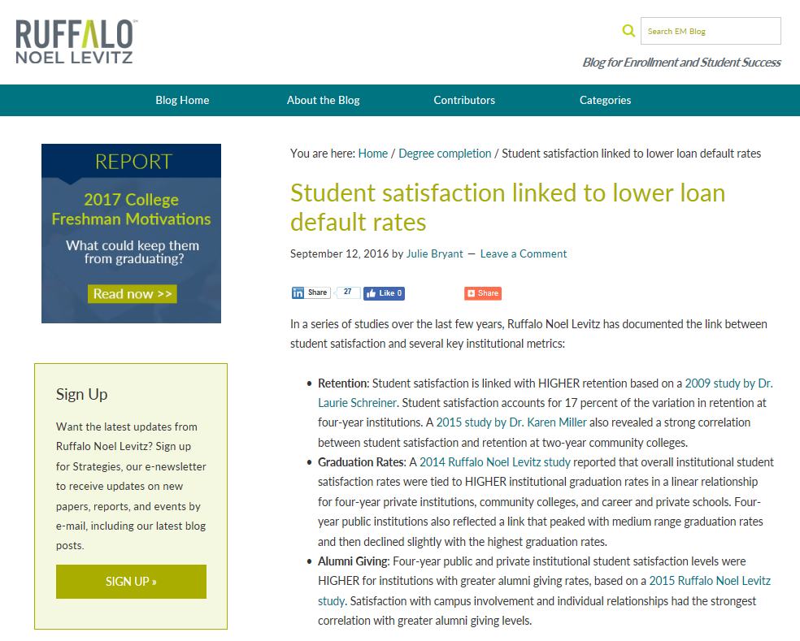
Alumni Giving:
The Correlation Between College Student Satisfaction and Alumni Giving (2015)
Loan Default:
Student satisfaction linked to lower loan default rates (A blog published on September 12, 2016 on http://blogem.RuffaloNL.com)
www.RuffaloNL.com/benchmark
Notes:
This will help you to know what you are looking for. The last one is a blog article rather than a full report.

Slide 9
Effective Practices for Student Success, Retention and Completion
Effectiveness of retention practices
 | Institution type | Using method | Very or somewhat effective
Using student satisfaction assessment data to make changes to address attrition | 4-Year Public | 85.2% | 60.9%
 | 4-Year Private | 91.0% | 87.3%
 | 2-Year Public | 88.9% | 68.8%
2017 Ruffalo Noel Levitz Effective Practices Report for Student Success, Retention and Completion
Notes:
We also know that a lot of institutions recognize the importance of using satisfaction data for retention purposes. This table presents the responses to the 2017 Effective Practices Report for Student Success, Retention and Completion, which is also available on the Ruffalo Noel Levitz website. As you can see, a large portion of institutions of all types indicate that they are using student satisfaction assessment and the majority find them to be effective retention practices. So this is the bandwagon rationale – lots of institutions are doing it and you should too!
NOTE: Also data could be added to this chart on this item:
Assessing what’s important to currently enrolled students to help ensure their satisfaction and success.
4 yr publics: 81.5% / 63.6%
4 yr privates: 93.7% / 77.0%
2 yr publics: 83.3% / 60.0%

Slide 10
Student Satisfaction Inventory (SSI)
Available since 1994
Used by more than 2800 institutions with nearly 6.2 million individuals
40+ or 70+ items rated for importance and satisfaction, clustered into scales, versions specific to institution types
Opportunity to add 10 campus defined items
Enrollment factors rated for importance
Three standard summary items
Standard demographics
Paper or online administrations
Across class levels
Any time during the academic year
Survey options for adult and online learners as well
Learn more here: www.RuffaloNL.com/SSI
Notes:
Let me introduce you to the Student Satisfaction Inventory or the SSI. You can see that it is has been widely used in higher education over the past 20 plus years. There are survey versions specific to institution types, including four-year institutions, community colleges and two-year career schools and the number of survey items rated for importance and satisfaction varies for each version. All of the survey versions offer you the opportunity to include customized items and the surveys can be administered via paper or online options. The SSI is intended to be administered across a representative sample of your student population, including all class levels and it can be administered any time during the academic year to your currently enrolled students. I also want you to be aware that we have survey options for adult and online learners if you are serving those populations as well. You can learn more about the SSI and see samples of the surveys on our Website, using the short cut SSI.

Slide 11

Definition of satisfaction
When expectations are met or exceeded by the student’s perception of the campus reality.
Schreiner & Juillerat, 1994
Notes:
This is how we define student satisfaction. It is when expectations are met or exceeded by the student’s PERCEPTION of the campus reality. You can see that a key word in this definition is PERCEPTION and it is important to keep in mind that perception really is reality. Sometimes you get your results back and you think, that’s not the way it is on our campus. But if that is the way your students perceive it to be, then that is their reality! The other important word here is EXPECTATIONS because they provide the context with which to consider the student experience.

Slide 12
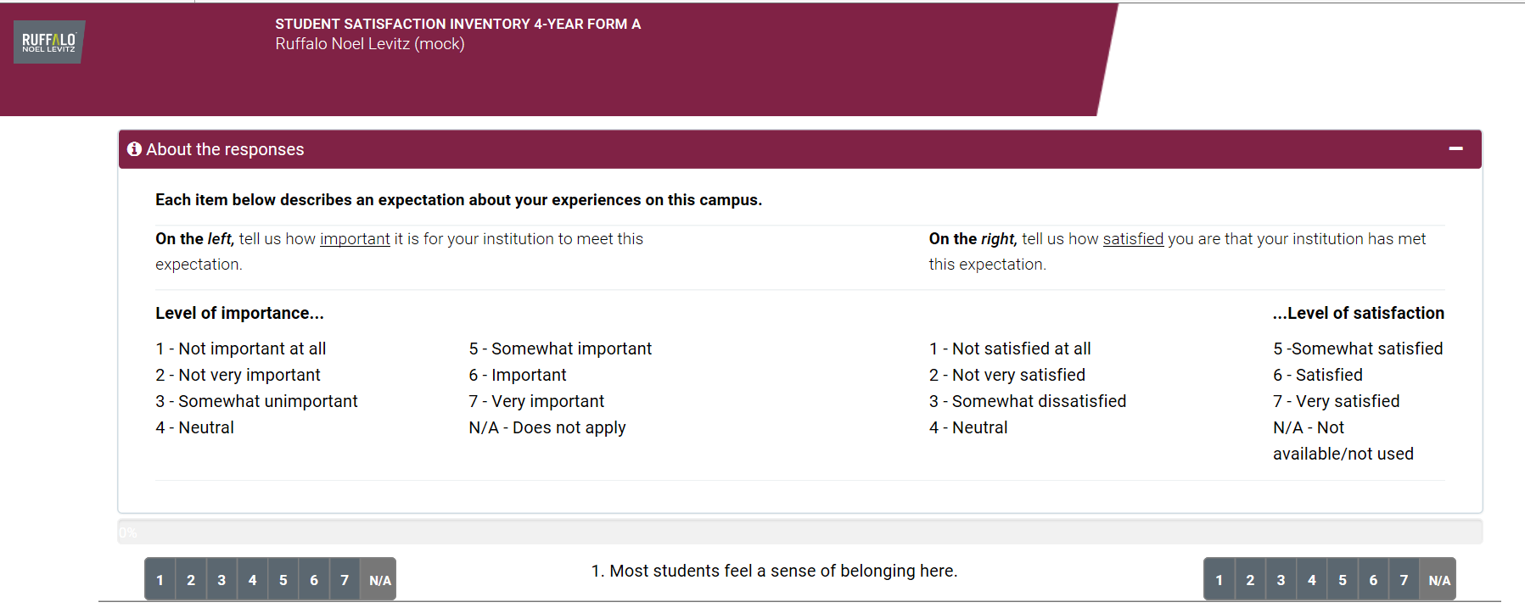
The RNL surveys capture both an importance score and a satisfaction score
The combination allows you to review your satisfaction results within the context of what is most important to your students.
Notes:
The surveys from Ruffalo Noel Levitz capture both an importance score and a satisfaction score. This combination of data allows you to review your satisfaction results within the context of what is most important and what truly matters to your students.

Slide 13
Matrix for Prioritizing Action
Very
Important
Institutional
Challenges
Institutional
Strengths
Very Dissatisfied
Very
Satisfied
Very
Unimportant
Notes:
With this combination of data, we can identify areas of strength, which are items with high importance and high satisfaction. These are the areas to celebrate on campus. We are also able to identify areas of challenge which are high importance but low satisfaction. And we are not going to be immediately concerned with the items that are in the bottom half of importance.

Slide 14
The results are compared with a national comparison group
National data is specific to survey version administered
Notes:
Your institutional results are presented up against the appropriate national comparison group based on your institutional type, so you will be able to see where your students are significantly more or less satisfied than students nationally.

Slide 15
National comparison groups from the Ruffalo Noel Levitz Satisfaction-Priorities Survey Suite: Fall 2014-Spring 2017
Student Satisfaction Inventory™ (SSI) is for traditional students, primarily enrolled on campus
Four-year privates: 217,956 students at 332 institutions
Four-year publics: 71,029 students from 73 institutions
Community colleges: 162,081 students at 195 institutions
Career and private schools: 31,412 students at 53 institutions
Adult Student Priorities Survey™ (ASPS) appropriate for undergraduate or graduate adult students.
72,124 adult students (graduate and undergraduate) at 153 institutions
Priorities Survey for Online Learners™ (PSOL) for students in online distance learning programs.
128,988 online learners at 164 institutions
Notes:
This slide gives you an idea of the depth and breadth of the national comparison group data which is available for each survey version. The national norms are updated annually and reflect three academic years’ worth of data.

Slide 16
Systematic assessment cycle
Notes:
Many campuses are using a systematic approach to using their satisfaction survey data.

Slide 17
Systematic Assessment Cycle
Inform the campus
Survey your students
Respond to the data with new initiatives
Review and share the results
Explore the data
Notes:
Here is a suggested step by step approach as part of a systematic assessment cycle. I am going to take a few minutes and walk you through each of these five steps to give you a better idea of how you could follow a similar approach at your institution.

Slide 18
Survey your students
Notes:
First up, surveying your students.

Slide 19
What needs to be determined?
When are you going to survey?
Fall or spring? Which specific weeks of the academic year?
Establish a regular cycle that makes sense with the other surveys you are administering
How are you going to survey?
Paper or online?
Who are you going to survey?
Entire population? A special subpopulation of students?
Traditional students and adults and online learners?
Notes:
Here are a few things that you will want to determine as you launch a survey administration. The first question you will need to answer is when are you going to survey. We have a 40-60 split between institutions that survey in the fall and those that choose to survey their students in the spring. You will want to find the timeframe that will work best for you and then plan to stick with that going forward for future administrations. You will then want to think about how you want to survey with either paper instruments or with online invitations. I can tell you that most institutions are currently using the online method and finding it to be successful and we can assist you with that process with our online system. You will also want to think about who you are going to survey. We generally recommend that you invite 100% of your population with an online administration. The important thing to note here is that you are striving for a representative sample across all class levels of your student population.

Slide 20

Critical step: Communication on campus in advance of the survey
Campus personnel: Faculty and staff
Students
Notes:
I also encourage you to think about the communication that is done in advance of the survey. We find that the most successful institutions have intentionally communicated with students and campus personnel in advance of the survey to let everyone know why you are surveying, when you are surveying, how you are surveying and what you plan to do with the data when you receive it.

Slide 21

Notes:
Here is an example from Mansfield University of a poster they placed around campus to be sure everyone knew the survey was going to be conducted.

Slide 22
Review and share the results
Notes:
The second step is to review and share the results.

Slide 23
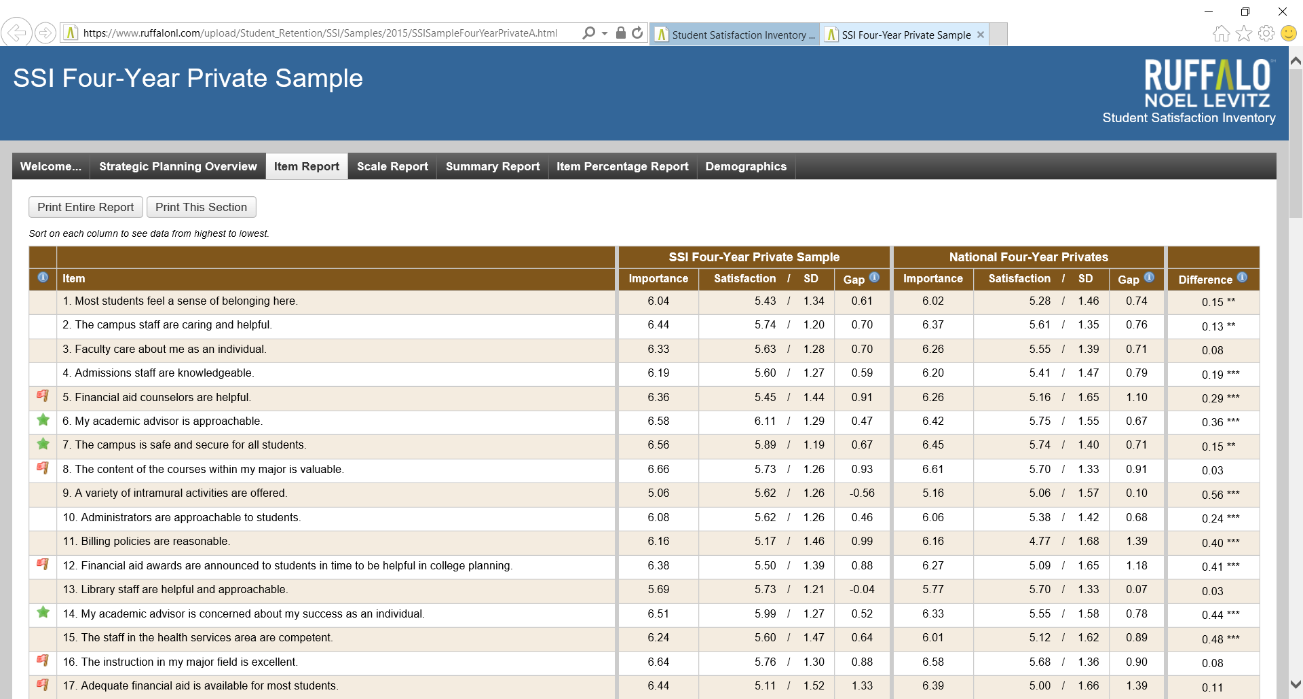
www.RuffaloNL.com/SSISamples
Notes:
I want to give you a sense of how the data are delivered to you. You can see in this screen shot that you get your data for each individual item on the survey, up against the corresponding national comparison group. We also highlight for you the green star strength items and the red flag challenge items. And on the other tabs of the report, you can see the data in a variety of ways. You get a feel as you look at the items shared here that the survey is very comprehensive and provides a big picture view for you on the student experience. You are welcome to visit our Website with the shortcut SSI Samples, as noted on the top of this visual, to explore the report samples yourself.

Slide 24

Review the results with:
Top leadership
Faculty and staff
Students
Notes:
When you review the results, be sure to share them with the top leadership and the faculty and staff, and your students.

Slide 25



Share the results through a variety of methods
Presentations
Written executive summaries
Bite size nuggets
One-on-one meetings
Group brainstorming sessions
Notes:
You will want to look for a variety of methods to share the results, depending on the audience. Whenever possible, focus on the story the data tells and not just the numbers in the reports.

Slide 26

Make the data relevant to the audience
Notes:
It is also especially important to make the data relevant to the audience.

Slide 27
There is relevant data for many areas on campus:
Enrollment managers
Academic affairs
Student affairs
Directors of retention
Accreditation committee
Institutional research
Notes:
The Student Satisfaction Inventory has data elements that are relevant for many different departments on campus. You can see the list here. I would be happy to visit with you to provide more details on the specific data points that each department would be most interested in.

Slide 28

Be sure to tell people what next steps are planned with the data
Notes:
As you share the results on campus, I strongly encourage you to be sure to tell people what next steps are planned with the data because taking action is how you can ultimately improve student satisfaction.

Slide 29
Explore the data
Notes:
The third step is to explore the data.

Slide 30

Digging deeper into the data will help you to understand what changes could be made on campus
Notes:
I think you will find that digging deeper into the data will help you to understand what changes could be made on your campus.

Slide 31
Ways to explore your data:
How satisfied are your subpopulations?
Raw data analysis
Target group reports
What else are students sharing with you?
Comments document from online administrations
Focus group discussions and brainstorming sessions
Students
Campus personnel
Notes:
Here are some of the possible ways that you can further explore your data. These include slicing the data to look at the responses by different subpopulations to see which students are more or less satisfied. With the online administrations, we also gather student comments, so I encourage you to spend time reviewing these as well. And a critical step to really understand what the items mean on your campus is to conduct focus groups.

Slide 32
Key demographic variables to review:
Class level
Enrollment status: Part-time / Full-time
Day/Evening students
Majors/Programs
Other variables to consider:
Gender
Race / Ethnicity
Employment
Campus location (if used as campus item)
Notes:
Here are a few of the key demographic variables that may be appropriate for you to review from your data set. I think these are the ones that are most actionable with targeted initiatives.

Slide 33


Focus Groups with two groups on campus:
Students
Campus personnel
Notes:
As you think about conducting focus groups, you will want to find ways to meet with both student groups and with groups of your campus personnel. Your students can share what they are experiencing and your campus personnel can provide suggestions from their perspective.

Slide 34
Focus groups can be very eye opening. What you think an item means to students may not be how they interpret it at all.
SSI Client, 2016
Notes:
This quote from a client really captures the value of conducting focus groups: She says, Focus groups can be very eye opening. What you think an item means to students may not be how they interpret it at all. So take the time to have discussions on campus to better understand the experience students are having, and what’s nice with the student satisfaction data as a starting point, is you will be able to have very focused focus groups.

Slide 35

Bring all the data back to a task force/committee for review and discussion
Notes:
You will want to bring all that information back to an established task force or committee for review and discussion.

Slide 36

Begin deciding what you are going to do differently…
Notes:
And then the work begins to decide what you are going to do differently.

Slide 37
Respond to the data with new initiatives
Notes:
Which takes us to step four – responding to the data with new initiatives.

Slide 38
What can be done on your own campus?
1
What is actionable?
2
What is perception?
3
What is beyond your control, so you just need to be aware of it?
Notes:
You will be able to consider your results to determine what is actionable. What is perception? And are there things that may be beyond your control, but you still need to be aware of them.

Slide 39
Matrix for prioritizing action
Very
Important
Institutional
Challenges
Institutional
Strengths
Very Dissatisfied
Very
Satisfied
Very
Unimportant
Copyright 1994-2016 Ruffalo Noel Levitz
Notes:
We looked at this matrix earlier in the presentation. I share it again now because it helps you to think about how you will want to prioritize your actions. In the reports we deliver to you, we identify your strengths and your challenges, using this conceptual model. Your strengths, or the areas where you are doing well, are items with high importance and high satisfaction. These are the areas you will want to celebrate. On the other side are the items that are still very important to your students but have lower satisfaction. These are your challenges and these are places where your students think you can be doing even better. These are your priority areas for improvement because they matter to students and you are not currently meeting their expectations. This is where you will want to focus your resources and your attention to increase student satisfaction.

Slide 40
Three ways to address your challenges
“Just do it”
Future–strategic plan
Change perceptions
through communication
Notes:
I suggest three ways to address your challenges. The first are the “just do its”. Where can you change policies or procedures that don’t make sense for students or your campus personnel for that matter? But you may not be able to fix everything right away. So the second segment are those things that will need more resources and more research, and should be part of your future strategic planning. They need to be addressed, just not now. But just be sure that they stay in that plan. And the third segment are items where you can improve student satisfaction by using information to change perceptions. Sometimes we don’t have to change a policy or procedure; we just need to communicate around it better. Communication is such a powerful way to improve satisfaction but you need to be intentional with how and when you are communicating particular points to your campus community.

Slide 41
Example: Billing policies are reasonable
Just do it: Change policies so payments are not due until after financial aid has been dispersed.
Future plan (within two years): Add automatic withdrawal options for monthly payments.
Change perceptions with information: Send a communication to students (and parents of traditional-age students) regarding payment options six weeks prior to semester start in the fall and spring.
Notes:
Let’s look at the item “Billing policies are reasonable.” to illustrate this concept. The Just Do It may mean changing policies so payments are not due until after financial aid has been dispersed. Seems pretty logical doesn’t it? But that’ not always the case for colleges. The future plan, may be to offer automatic withdrawal options for monthly payments. Something that may take you a year or two to get implemented. And the information approach may be to send a communication to students (and/or the parents of your traditional age students) regarding all of the current payment options, going out six weeks prior to the start of the fall or spring semesters. Couldn’t these simple actions help to improve student satisfaction with billing policies? And that’s what it really comes down to is identifying what are the simple things you can do on your campus to change the student experience. They may not be that hard to implement.

Slide 42

Makes changes in:
Processes
Policies
Perceptions
Notes:
So the idea here is to identify where can you make changes in processes, in policies and in perceptions.

Slide 43
Student satisfaction data can support efforts in:
Retention
Strategic Planning
Accreditation
Recruitment
Notes:
It is also helpful to keep in mind that satisfaction data can support a variety of efforts on campus. Institutions tell us that they are using the data for retention and student success efforts, to provide the student voice in strategic planning activities, to provide valuable documentation for accreditation efforts and for internal market research purposes for recruitment efforts. You may be using or planning to use the data in one of these areas, but I encourage you to look for ways to expand the use of the data on your campus into all four activities.

Slide 44
Be sure you can point to what actions you have taken when it is time to survey again…
Notes:
Most institutions we are working with, survey their students every other year. As you think about your own assessment cycle, you will want to be sure that you can point to actions that you have been taken based on the student responses, especially before it’s time to survey again. Remember, no action, no improvement in student satisfaction.

Slide 45

Notes:
The final step in the systematic assessment cycle is to close the feedback loop and inform the campus of the actions you have taken.

Slide 46
When and what to communicate:
When receive results communicate about the current satisfaction levels and areas of importance
When gather information communicate to change perceptions about the way things currently are
When make a change communicate that the change was made
When preparing for the next survey administration communicate what has been done since the last survey administration
Notes:
Here are some suggestions for when and what to communicate at your institution. When you receive your results, you will want to communicate about the current satisfaction levels and areas of importance to your students. When you gather more information with focus group sessions, you may want to begin communicating to change perceptions about the way things currently are. Keep in mind that perceptions are reality, so you may have a lot of opportunities to change perceptions. It’s especially important that when you make a change to a policy or procedure that you communicate that the change was made. Be intentional in those communications and don’t assume that everyone is automatically aware that something is different. And as you prepare for your next survey administration, you will want to purposely communicate what has been done since the last survey administration. Now this assumes that you have taken particular actions, so be sure you are proactive to that extent. But then be prepared to share the laundry list of improvements to encourage students to complete the survey this time around, knowing that their responses are key elements for decision making at your institution.

Slide 47
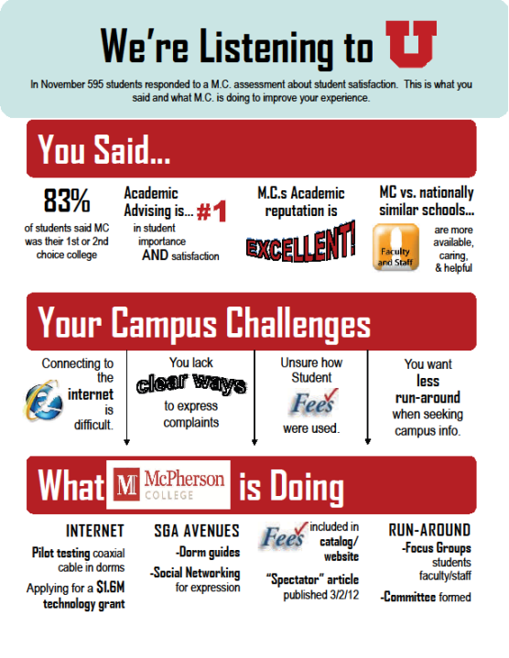
Notes:
Here is an example of a poster that was used on campus at McPherson College. As you can see in this example, you can say a lot by being creative.

Slide 48
Systematic Assessment Cycle
Inform the campus
Survey your students
Respond to the data with new initiatives
Review and share the results
Explore the data
Notes:
So here is one more look at the entire assessment cycle and you will notice that it keeps going because satisfaction assessment, or any assessment really, is not a once and done activity.

Slide 49
Typical cycles:
25%
Annually
50%
Every other year
Three or more years between surveying
25%
Notes:
I can share with you that the clients we work with typically survey on an every other year basis, often alternating with NSSE (the National Survey on Student Engagement) or CCSSE (the Community College Survey on Student Engagement), so that they are gathering both satisfaction and engagement student feedback data. Because they are really two different aspects of the student experience.

Slide 50
How is it working for campuses?
Notes:
So how is satisfaction surveying working for campuses?

Slide 51
At the institutional level, campuses who are actively working with their results:
Taking action to improve the student experience
Informing the students of the actions that have been taken
Assessing student satisfaction on a regular basis
Are able to positively influence student satisfaction perceptions year over year.
Notes:
I have seen at the institutional level, when campuses actively work with their results, taking action, informing the students and gathering student satisfaction data on a regular basis, campuses are able to positively influence student satisfaction perceptions over time. Keep in mind that just administering the survey is not enough. You need to be prepared to take action with the results to intentionally make improvements to the student experience.

Slide 52
National trends in student satisfaction
Notes:
Before we rap up today, I want to share a few highlights from the national trends. The full National Priorities and Satisfaction Report will be released later this fall, and I will be sure to let you know when it is available to download, but for now, let me give you a sneak peak.

Slide 53
2017 National Student Satisfaction and Priorities Report
Summary satisfaction and likelihood to re-enroll
© 2017 National Student Satisfaction and Priorities Report % of students indicating satisfied/very satisfied and probably/definitely would re-enroll
Notes:
First – let me share with you the overall levels of satisfaction and the overall likelihood for students to re-enroll if they had it to do over again. These are bottom line indicators on student satisfaction and these are the indicators that are most strongly linked to institutional graduation rates, retention, and alumni giving. The way institutions move the needle on these items is with the actions they take on the individual survey items, so let’s take a closer look at those.

Slide 54
2017 National Student Satisfaction and Priorities Report
I am able to register for classes with few conflicts.
© 2017 National Student Satisfaction and Priorities Report % of students indicating important/very important and satisfied/very satisfied
Notes:
The first item that I think may be of interest to you is the item “I am able to register for classes with few conflicts.” This chart shows that at four-year privates for example, 89% of students indicate that this item is important or very important to them and only 53% are satisfied or very satisfied with it. You can see the corresponding percentages at four-year publics and community colleges. I can tell you that in the national data set, this item is identified as a top priority challenge at all three institution types.

Slide 55
Potential ways to respond to this item:
Analyze the data sliced by program/major to see where this item is more or less of an issue.
Track and identify which classes are in high-demand.
Determine what types of conflicts students are facing (prerequisites, timing, etc.).
Notes:
So what are some potential ways for you to respond to this item on campus? You could analyze the data by slicing it by student programs or majors to see where access to classes is more or less of an issue for one program vs. another. You could also intentionally track and identify which classes are in high demand each semester. You could also explore through focus group discussions what types of conflicts are students facing?

Slide 56
2017 National Student Satisfaction and Priorities Report
The personnel involved in registration are helpful.
© 2017 National Student Satisfaction and Priorities Report % of students indicating important/very important and satisfied/very satisfied
Notes:
Another item in this area is the perception of the registration personnel being helpful. Again, you can see the percentage of students indicating it is important or very important to them and the percent saying they are satisfied or very satisfied.
While this item is not a strength or a challenge for any institution types, it may be an area for you to focus on for your campus.

Slide 57
Potential ways to respond to this item:
Conduct focus groups to understand what students are experiencing with the registration staff.
Conduct customer service training with the staff.
Look at the policies and procedures regarding registration to understand if that is the issue vs. the personnel.
Notes:
Here are a few ideas for responding on this item. You could talk with students to understand what they are experiencing with the registration staff. If appropriate, you may want to consider implementing customer service training with this department and others on campus. You may also want to take another look at your policies and procedures because those could be affecting your registration’s staff ability to serve students.

Slide 58
2017 National Student Satisfaction and Priorities Report
My academic advisor is knowledgeable about requirements in my major.
© 2017 National Student Satisfaction and Priorities Report % of students indicating important/very important and satisfied/very satisfied
Notes:
This item on academic advisors being knowledgeable about requirements is very important across institution types. At four-year privates and publics, this item is considered a strength and while the scores are similar, it is considered a challenge item in the community college data set.

Slide 59
Potential ways to respond to this item:
Improve the resources available to advisors regarding requirements.
Consider the processes and procedures in place for advising.
Provide opportunities to build relationships between students and advisors to improve the overall advising relationship.
Notes:
If this item were a challenge at your institution, you may want to consider improving the resources available to advisors regarding current requirements by each major. You could also consider examining the processes and procedures in place for advising and look for opportunities to improve student and advisor relationships.

Slide 60
2017 National Student Satisfaction and Priorities Report
I seldom get the run-around when seeking information on this campus.
© 2017 National Student Satisfaction and Priorities Report % of students indicating important/very important and satisfied/very satisfied
Notes:
One more item I want us to take a look at and that is the perceptions of getting the run-around on campus. At the national level, this item is not a strength or a challenge, but it may be area where your campus could improve.

Slide 61
Potential ways to respond to this item:
Identify what types of run-around students are experiencing.
Consider phone, online and in-person run-around issues
Examine policies and procedures for billing, dropping/adding classes, registration, etc. to remove multiple steps whenever possible.
Notes:
This is another place where discussions with students and campus personnel can help you to identify the types of run-around students are experiencing. And keep in mind that the run-around may be on the phone, or with your Web resources as well as physically having students run all around campus. I encourage you to take another look at your policies, especially when it comes to billing, dropping or adding classes, registration, etc. and find ways to remove multiple hoops for students to jump through whenever possible.

Slide 62

What are the top issues on your campus?
Notes:
So as you consider the top issues nationally, do you know what the top issues are on your own campus? Conducting a student satisfaction assessment would help you to identify your priorities for improvement based on what your students think.

Slide 63
Resources to Support Your Efforts
Notes:
Before we conclude, I have a few resources that I want to share with you to support your efforts.

Slide 64
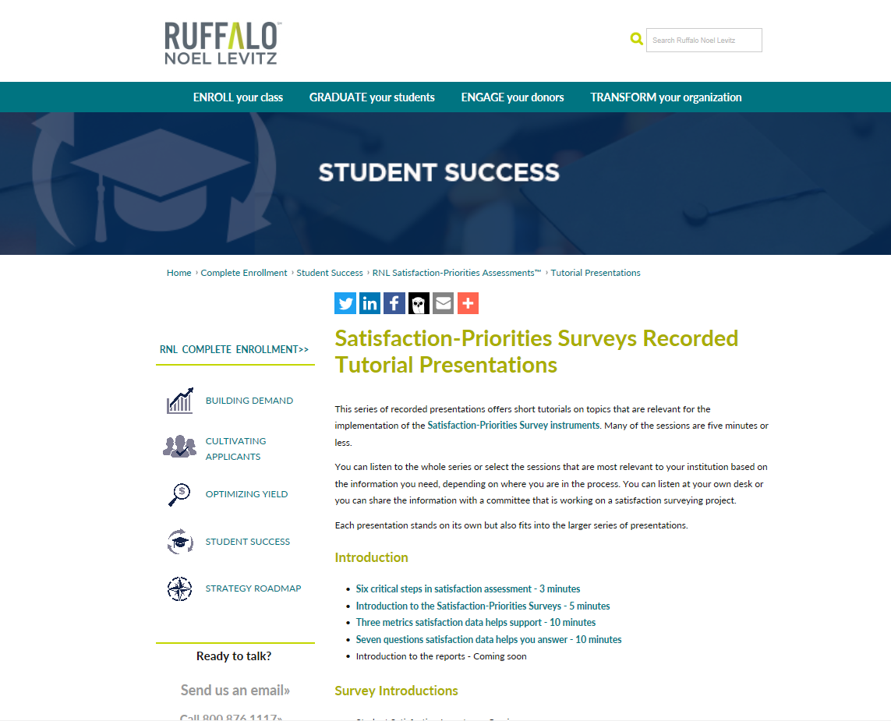
www.RuffaloNL.com/SatisfactionSurveyTutorials
Notes:
There is more information on our Website that I invite you to review, including short 7 to 10 minute tutorials on a variety of introductory areas and a deeper dive on each of the 5 steps in the systematic assessment cycle as well as other sessions to support your efforts.

Slide 65
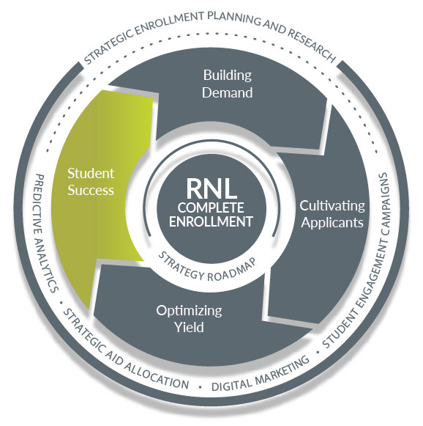
www.ruffalonl.com/completeenrollment
Ruffalo Noel Levitz Complete Enrollment
Identify your ideal students and engage them from
search to graduation
www.ruffalonl.com/completeenrollment
Notes:
Also, please be aware that Ruffalo Noel Levitz can assist you in a variety of ways to improve overall enrollment at your institution. The Student Satisfaction Inventory is part of our Student Success component which helps you with your retention efforts, but we can also provide assistance throughout the student life cycle. You can learn more on our Website.

Slide 66
Student Satisfaction Data: Overcoming Barriers and Facilitating Use
A Webinar Featuring Three Case Study Presenters Tuesday, October 24, 2017 at 2:00 p.m. eastern time
Palm Beach Atlantic University (FL)
Cuyahoga Community College (OH)
Wright State University Main Campus (OH)
Learn more and register for the FREE Webinar here: www.RuffaloNL.com/Events
Notes:
If you would like to hear more about how campuses are using their student satisfaction data to make improvements and what approaches have worked best, I invite you to join us for another Webinar on Tuesday, October 24th at 2:00pm eastern time, featuring Palm Beach Atlantic University, Cuyahoga Community College and Wright State University. There will be more information and you can register for the FREE webinar on the RuffaloNL website.

Slide 67
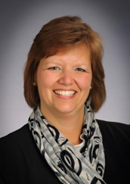

For more information, contact:
Julie Bryant
Associate Vice President, Retention Solutions
Julie.Bryant@RuffaloNL.com
Phone: 800-876-1117
Shannon Cook
Senior Director, Retention Solutions
Shannon.Cook@RuffaloNL.com
Phone: 800-876-1117

Slide 68

Addressing Your Comments and Questions
Questions
Don’t miss our next webinar October 30 at 3.00 PM Eastern with Ellen Stolzenberg, Associate Director of the UCLA Higher Education Research Institute, as she discusses the Your First Year College Survey.
To register click here or visit: https://register.gotowebinar.com/register/2885353093045422081

