Slide 1
  Astra Academy: What Student Engagement Tells Us About Our Undergraduates
John Barnshaw, Ph.D. (jbarnshaw@aais.com)
Associate Vice President – Research and Statistics
Ad Astra
Alexander McCormick, Ph.D.
Director – National Survey of Student Engagement
Indiana University-Bloomington

Slide 2
Presentation Overview
Introduction (5 Minutes)
Student Engagement and Our Undergraduates (35 Minutes)
Wrap-Up (5 Minutes)
Comments and Questions (15 Minutes)

Slide 3
About Ad Astra
Ad Astra is a course scheduling and enrollment management organization that partners with over 600 institutions annually to improve course scheduling efficiency and accessibility for students.
Ad Astra offers unique solutions design to improve student retention, reduce time-to-completion, and improve graduate rates.
Astra Academy is a webinar series that brings together diverse stakeholders across the higher education landscape to share with you how their work is helping to improve student outcomes with a focus on student retention, time-to-completion, or graduation.

Slide 4
Insights from a Random Sample of Students at a Two-Year Institution
Variable | Full-Time Student (Age 18 – 24) | Full Time Student (Age 25+)
Sample Population | 343 (60%) | 229 (40%)
Completed < 30 Student Credit Hours | 52.7%** | 47.3%***
Frequently work outside of class to prepare assignments. | 32.8%* | 23.2%*
Percent Reported Never Skipping Class | 61.0%*** | 79.5%***
Percent Reported Working 0 Hours Each Week | 29.8%*** | 48.0%***
Percent Reported Working 30+ Hours Each Week and/or Taking Care of Dependents | 16.4%*** | 54.2%***
Percent of Students Earning “A” | 18.5% | 25.4%
* - p < .05 ** - p < .01 *** - p < .001
Notes:
The Community College Survey of Student Engagement (CCSSE), – questions about what you do outside of the classroom
Chi Squared test
Full Time Students Only – More Part Time Adult Learner
Red is statistically significant findings
The single biggest opportunity is to come to class
Full-Time Adult Learners make up a smaller proportion of 30+ student credit hour generation than other full-time students.
Full-Time Adult Learners are less likely to work, but more likely to have dependent responsibilities.
Full-Time Adult Learners are more likely to report an “A” average and less likely to report skipping class.

Slide 5
Regression Predicting Cumulative Student GPA at a Two-Year Institution
Variable | Beta | Standardized Coefficient | Significance | Tolerance | VIF
Constant | 2.340 |  | .000
Total Cumulative Student Credit Hour Production (Hours) | .004 | .233 | .000 | .860 | 1.163
Age (Years at Semester Start) | .010 | .161 | .012 | .789 | 1.267
Developmental Writing (1= Have Not/Do Not Plan) | -.105 | -.135 | .019 | .986 | 1.014
Parent/Spouse Source of Income (1= Not a Source) | .182 | .132 | .030 | .883 | 1.133
How Supportive is Immediate Family (1= Not Very) | .202 | .182 | .002 | .969 | 1.033
Likelihood Being Academically Underprepared Cause Withdrawal (1=Not Likely) | -.145 | -.175 | .003 | .952 | 1.050
Skip Class (1= Never) | -.188 | -.136 | .025 | .879 | 1.137
* - p < .05 ** - p < .01 *** - p < .001

Slide 6
What Student Engagement Tells Us About our Undergraduates
Alexander C. McCormick
Center for Postsecondary Research
School of Education, IU Bloomington
Astra Academy Webinar
February 27, 2018

Slide 7
What is Student Engagement?
Why Does It Matter?

Slide 8

What is Student Engagement?
  The extent to which students are exposed to and participate in effective educational practices
  Educationally purposeful activities and practices
  Empirically linked to desired outcomes

Slide 9
OK, but what is Engagement?
Challenging academic work
  High expectations
  Time investment
  Advanced cognitive tasks
  (i.e., deep learning)
Enriching learning activities
  Active, collaborative, & reflective learning
  High-impact practices
Quality involvement with faculty
In a context that promotes
and supports success

Slide 10
Conceptual & Empirical Foundations
Time on task (Tyler, 1930s)
Quality of effort (Pace, 1960s & 70s)
Student involvement (Astin, 1984)
Academic & social integration (Tinto, 1975 & 1987)
Good practices in
undergraduate education (Chickering & Gamson, 1987)
College impact (Pascarella, 1985)
Student engagement (Kuh, 1991, 2005)
Notes:
Pace (1970s)
Pioneer in this movement of looking at the entire student experience versus just looking at test scores or grades to assess student learning.
He asked questions related to students’ academic and social experiences in college – assessed how much effort they were putting forth in their educational experiences
Astin (Hired by Pace at UCLA in 1980s)
Promoted his theory of student involvement
Amount of learning taking place directly proportional to quantity and quality of energy invested in educational activities
Tinto (1970s & 80s)
Retention model – greater social and academic integration, both formal and informal processes -> greater satisfaction -> more likely to stay
Chickering and Gamson (1980s analysis of hundreds of studies over several decades)
1) Student-faculty contact, 2) Cooperation among students, 3) Active learning, 4) Prompt feedback, 5) Time on task, 6) High expectations, and 7) Respect for diverse talents and ways of learning
Kuh (1990s – idea of student engagement)
What students do -- time and energy devoted to educationally purposeful activities
What institutions do -- using effective educational practices to induce students to do the right things

Slide 11

Why Does It Matter?
The impact of college is largely determined by individual effort and involvement in the academic, interpersonal, and extra-curricular offerings on a campus. It is important to focus on the ways an institution can shape its offerings to encourage student engagement.
Paraphrased from
Pascarella & Terenzini (2005), p. 602

Slide 12

A Profoundly Different Approach to Assessing the Student Experience
  From satisfaction (happiness) to quality of educational experiences
  Strong focus on behavior rather than attitudes and opinions

Slide 13
Q: How can we measure student engagement?
A: Ask those who are most knowledgeable about the college experience…
Students!

Slide 14

A Closer Look at NSSE
A research and service project of the Indiana University Center for Postsecondary Research
Launched in 2000
More than 1,600 4-year colleges and universities 2000-2018
Online survey of first-year and senior undergraduates (census)
Community college counterpart: Community College Survey of Student Engagement (CCSSE, based at UT Austin; ccsse.org)

Slide 15
NSSE Survey Content
Academic activities & experiences
  Active learning
  Learning with peers
  Reading and writing
  Cognitive tasks in courses
  High-impact practices
Experiences with faculty
Time use
  Study, work, socializing…
Co-curricular activities
Institutional emphases
Quality of campus relationships
Perceived cognitive & noncognitive gains
Satisfaction
Demographic & enrollment characteristics

Slide 16
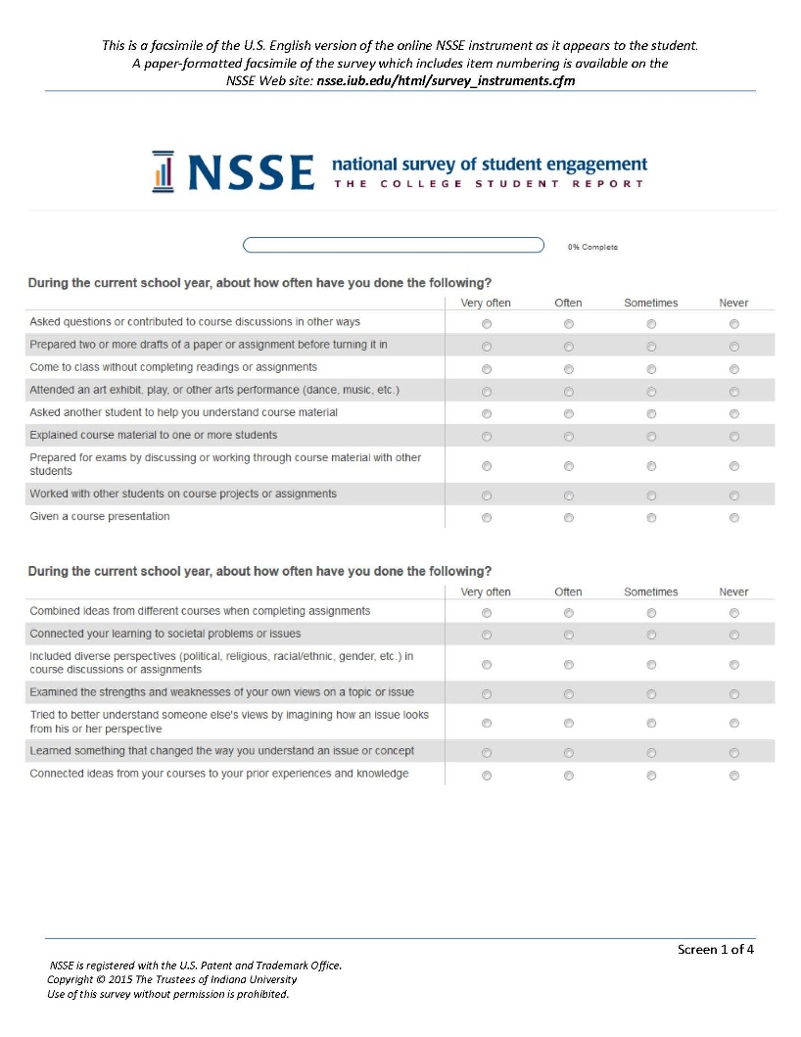
How It Works
Web-based & mobile-optimized
Uniform, centralized survey administration
Customizable invitations & reminders
Institutions receive detailed reports and identified student data
Comparison group results (customizable)
Results are confidential

Slide 17
Sample NSSE questions

Slide 18
During the current school year, about how often have you done the following?
Reviewed your notes after class
Reached conclusions based on your own analysis of numerical information (numbers, graphs, statistics, etc.)
Summarized what you learned in class or from course materials
Used numerical information to examine a real-world problem or issue (unemployment, climate change, public health, etc.)
Prepared for exams by discussing or working through course material with other students
Explained course material to one or more students
Asked another student to help you understand course material

Slide 19
During the current school year, about how often have you done the following?
Examined the strengths and weaknesses of your own views on a topic or issue
Prepared two or more drafts of a paper or assignment before turning it in
Tried to understand someone else’s views by imagining how an issue looks from his or her perspective
Discussed course topics, ideas, or concepts with a faculty member outside of class
Connected your learning to societal problems or issues?
Discussed your academic performance with a faculty member

Slide 20
During the current school year, about how often have your instructors done the following?
Clearly explained course goals and requirements
Used examples or illustrations to explain difficult points
Provided feedback on a draft or work in progress
Provided prompt and detailed feedback on tests or completed assignments

Slide 21
Summary Measures:
Engagement Indicators
Academic Challenge
Higher-Order Learning
Reflective & Integrative Learning
Learning Strategies
Quantitative Reasoning
Learning with Peers
Collaborative Learning
Discussions with Diverse Others
Experiences with Faculty
Student-Faculty Interaction
Effective Teaching Practices
Campus Environment
Quality of Interactions
Supportive Environment

Slide 22
Engagement Indicator Example
Collaborative Learning combines results from four survey items:
Asked another student to help you understand course material
Explained course material to one or more students
Prepared for exams by discussing or working through course material with other students
Worked with other students on course projects or assignments
During the current school year, about how often have you done the following?

Slide 23

Collaborative Learning
Seeking and giving help are vital learning strategies
1 in 5 first-year students have difficulty learning course material and getting help with courses
“Toughing it out” on your own is not a strategy for success
Notes:
Uri Treisman’s “Emerging Scholars” work

Slide 24
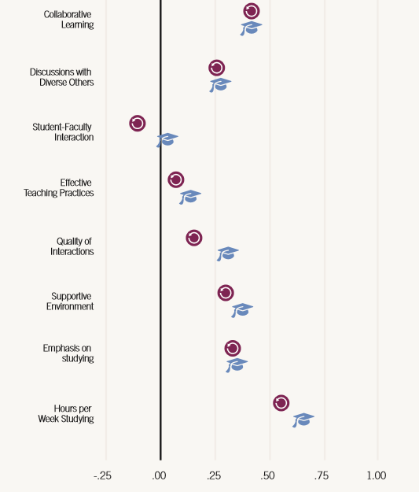
First-Year Student Correlations with Institutional Retention
& Graduation Rates

Slide 25
Engagement and Underserved Students
Engagement pays dividends for all students, but the payoff is higher for:
Underprepared students
Students of color

Slide 26
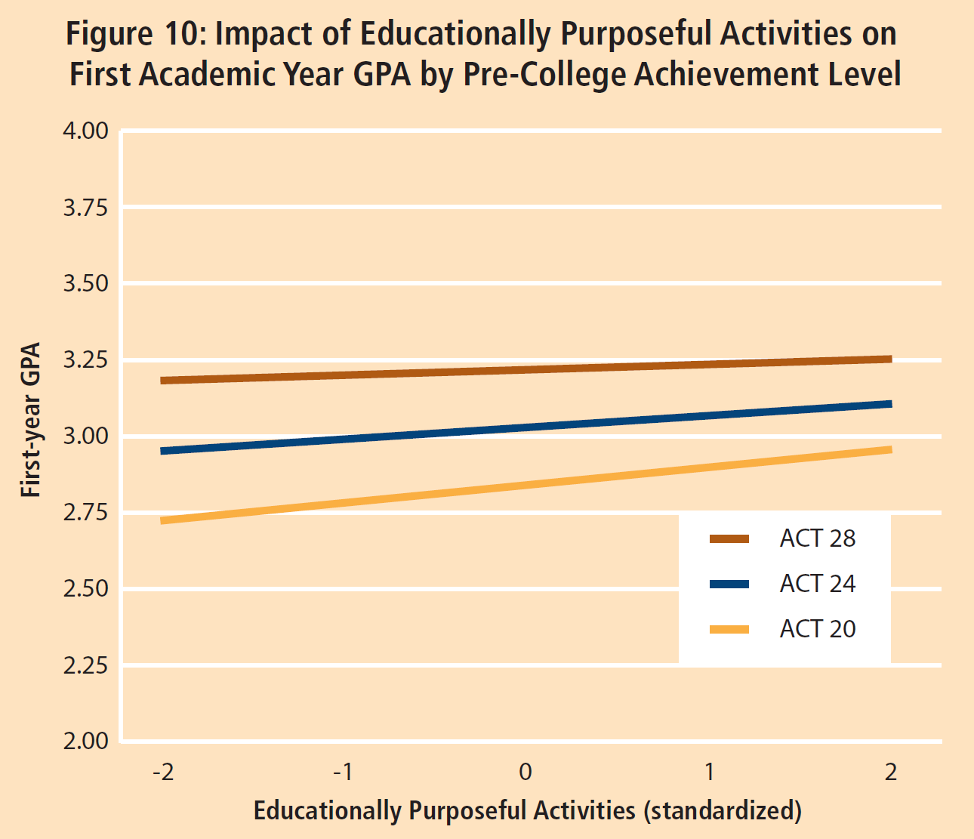

Slide 27
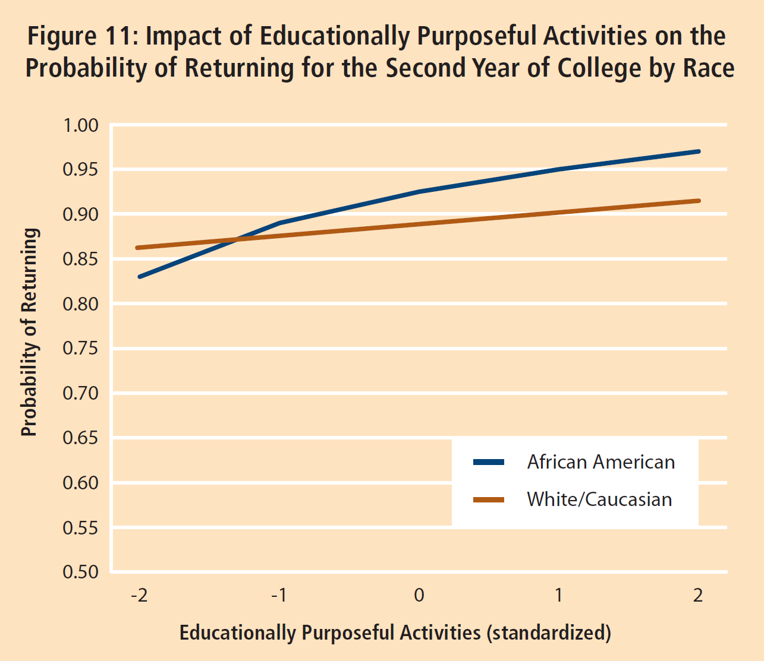

Slide 28
High-Impact Practices

Slide 29
Summary Measures:
High-Impact Practices (HIPs)
Learning community
Service-learning
Research with faculty
Study abroad
Internship, field experience, etc.
Culminating experience (senior project, capstone, etc.)
First-year and senior students
Seniors only

Slide 30
The Major is a Key Context that Conditions Engagement
Course Challenge
Study time

Slide 31
Course Challenge Among First-year Students, By Major or Intended Major
During the current school year, to what extent have your courses challenged you to do your best work?
[1=Not at all to 7=Very much]

Slide 32
Class Preparation Time Among Seniors, by Major
Preparing for class (studying, reading, writing, doing homework or lab work, analyzing data, rehearsing, and other academic activities)

Slide 33
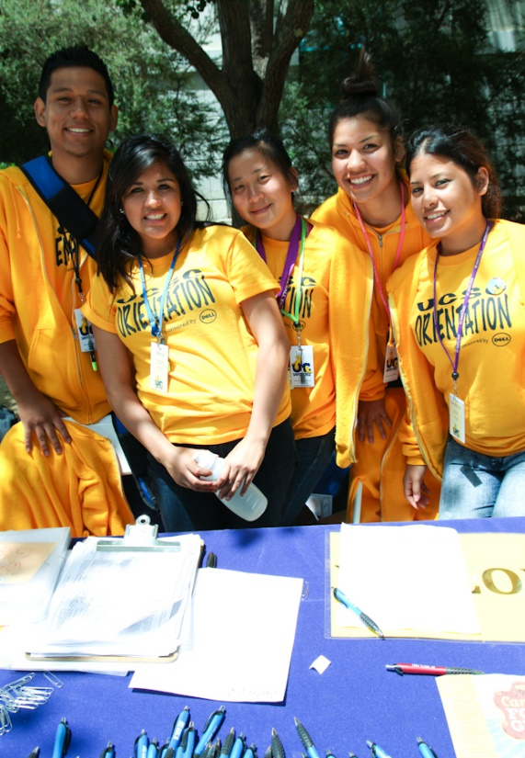

Q & A

